Slide 1
SOTA and Best Practices
Agents for Hardware Optimization in RAG+LLM System
Rui Vieira
October 16, 2025

Slide 2
RAG
Layers and features

Slide 3
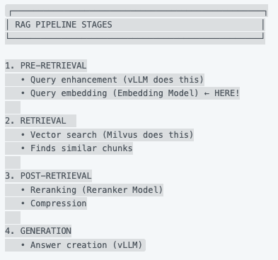
Modern RAG Stages

Slide 4
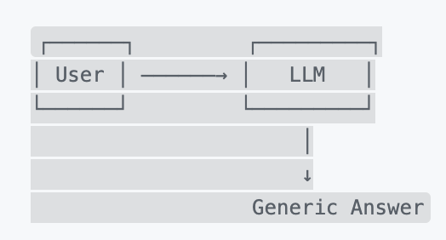
0 Naïve LLM
LLM with no context only ‘trained knowledge’

Slide 5
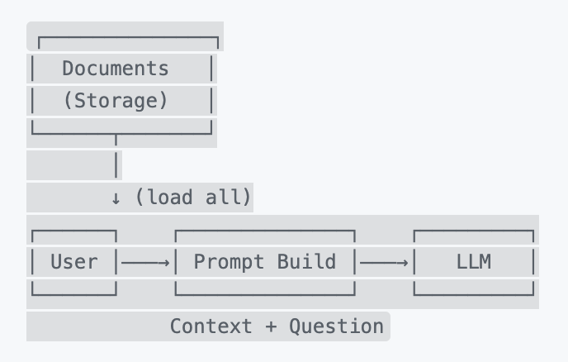
1 Naïve RAG
Problem: LLM doesn't know about our documents
Solution: Send document content with the question
additional LLM : NO
Flow
1. Upload documents
2. For each question, search ALL documents
What this gives
- LLM can reference your documents
- Grounded answers (not hallucinated)
Problems
- Token limit Can't fit 1000 documents in prompt
- Irrelevant context Sending everything confuses LLM
- Slow Loading all documents every time
- Expensive. Huge token costs

Slide 6
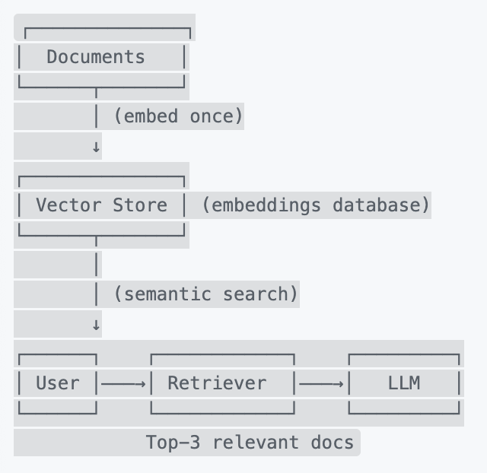
2 Retriever
Problem: Can't send all documents, need to find relevant ones
Solution: Semantic search using embeddings
additional LLM : YES
Flow
1. Index documents by embedding them (vectorizing them)
2. Query-time retrieval
a) prompt – documents similarity
b) finds the k-most similar
c) builds context from them
3. Answer
What This Adds
- Embedding Model Converts text → vector (768-dim)
- Vector Store In-memory list (later: Milvus/Pinecone)
- Similarity Search Cosine similarity find relevant docs
Problems
- Chunking Documents too long for single embedding
- Lost semantics Long docs lose nuance
- Scalability In-memory won't scale to millions

Slide 7
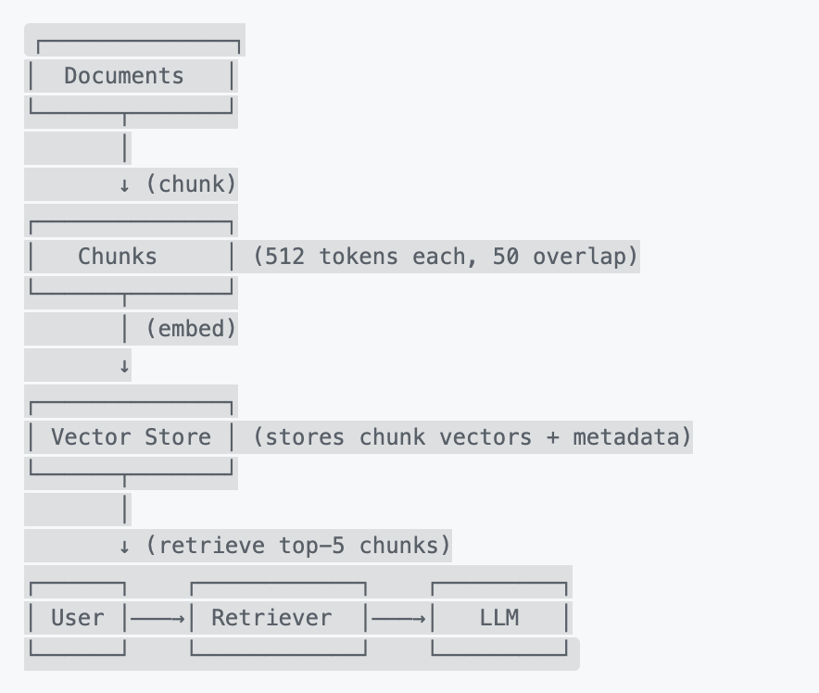
3 Chunking strategy
Problem: Documents are too long, embeddings lose meaning
Solution: Split documents into semantic chunks
Additional LLM : YES
Flow
1. Index documents by embedding them (vectorizing them)
2. Query-time retrieval
a) prompt – documents similarity
b) finds the k-most similar
c) builds context from them
3. Answer
What This Adds
- Chunking Logic Sliding window with overlap
- Metadata Preservation Track source document, page
- Granular Retrieval Fetch specific paragraphs, not whole docs
Problems
- Optimal chunk size? 512 tokens? 1024? Depends on use case
- Semantic boundaries May split mid-sentence
- List context Chunk may lack surrounding context

Slide 8
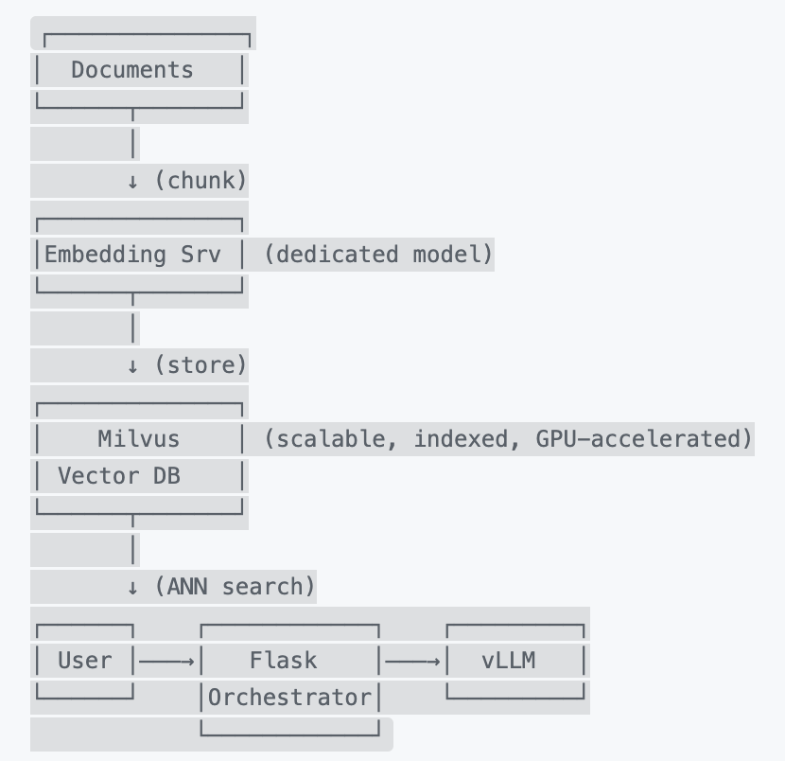
4 Vector database
Problem: In-memory vector store only – not saved
Solution: ‘Production’ vector database (Milvus, Pinecone, Weaviate)
additional LLM : YES
Flow
1. Connects
2. Define storage schema and index
3. Insert ‘chunks’
4. Embed and save
What This Adds
- Vector database
- Persistence Data survives restart
- Search Accelerated via GPU

Slide 9
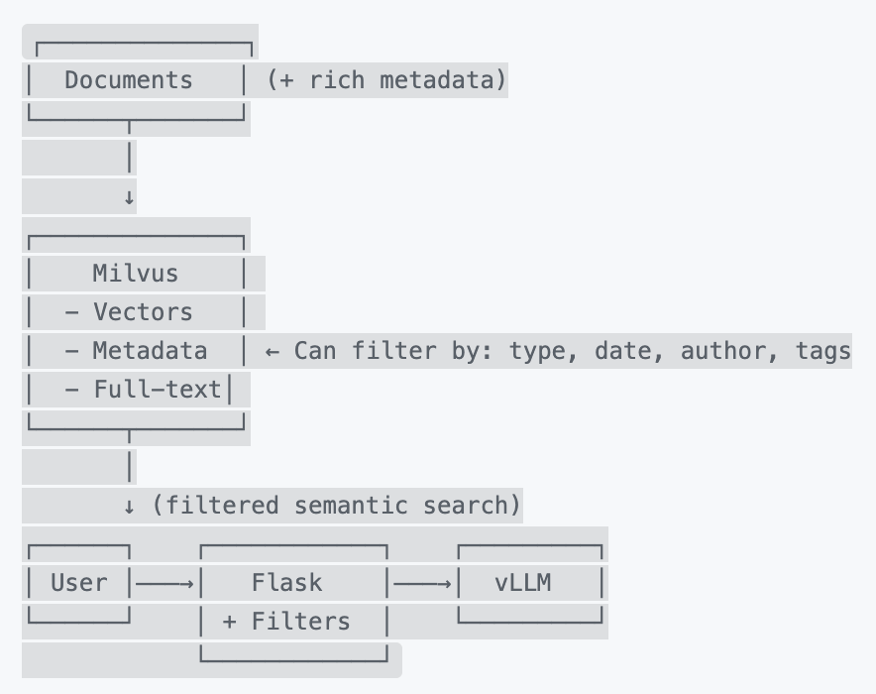
5 Adding Metadata
Problem: We want to search only specific document types or dates
Solution: Rich metadata + filtered search
additional LLM : NO
Flow
1. List Metadata
2. Filter by search
What This Adds
- Scoped search
- Compliance (restrict by access level)

Slide 10
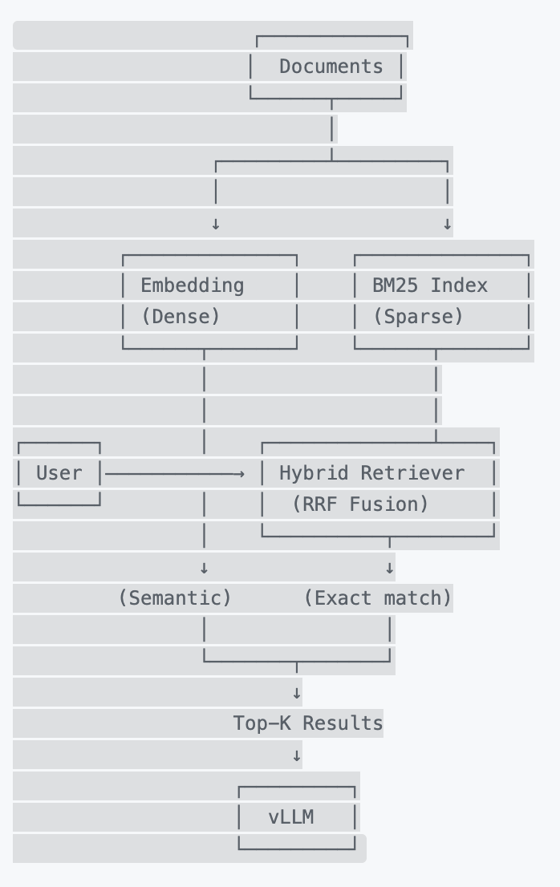
6 Hybrid Search (Sparse + Dense)
Problem: Vector search fails on exact keywords
Solution: Combine semantic search (vectors) + keyword search (BM25)
additional LLM : NO
Flow
1. Index keywords search
2. Evaluate scores between sparse and dense
3. Return top K- Results
What This Adds
- BM25 Index: TF-IDF based keyword search
- Reciprocal Rank Fusion: Combines rankings from both methods
- Alpha Parameter: Weight : semantic (0.5) vs keyword (0.5

Slide 11
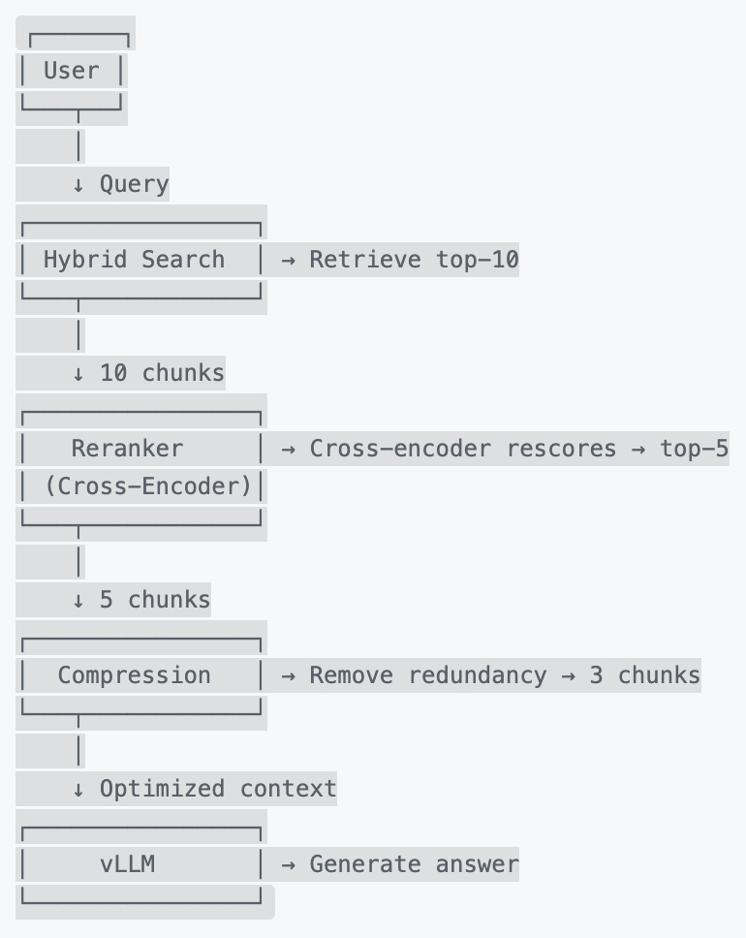
7 Post-Retrieval Optimization
Problem: Top-5 chunks may have redundancy or noise
Solution: Rerank and compress before sending to LLM
additional LLM : YES
Flow
1. Retrieve chunks
2. Rerank
3. Remove duplicate / similar sentences
What This Adds
- Reranker: Cross-encoder model (more accurate than bi-encoder
- Compression: Deduplication, removes noise
- Two-stage retrieval: Fast retrieval (10) → Slow reranking (5)

Slide 12
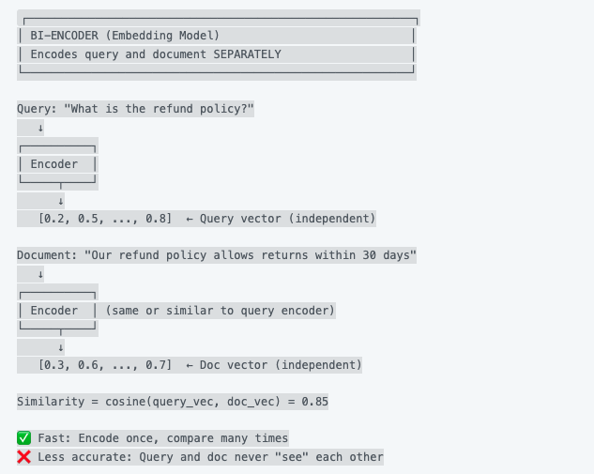
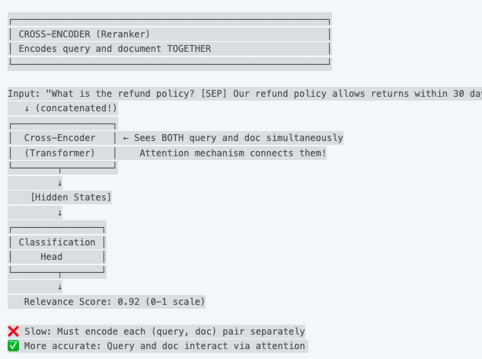
7 Post-Retrieval Optimization
Each text is encoded independently.
The query encoder never sees the document content during encoding.
Query and document are encoded together.
The model sees both at the same time, so it can learn interactions.

Slide 13
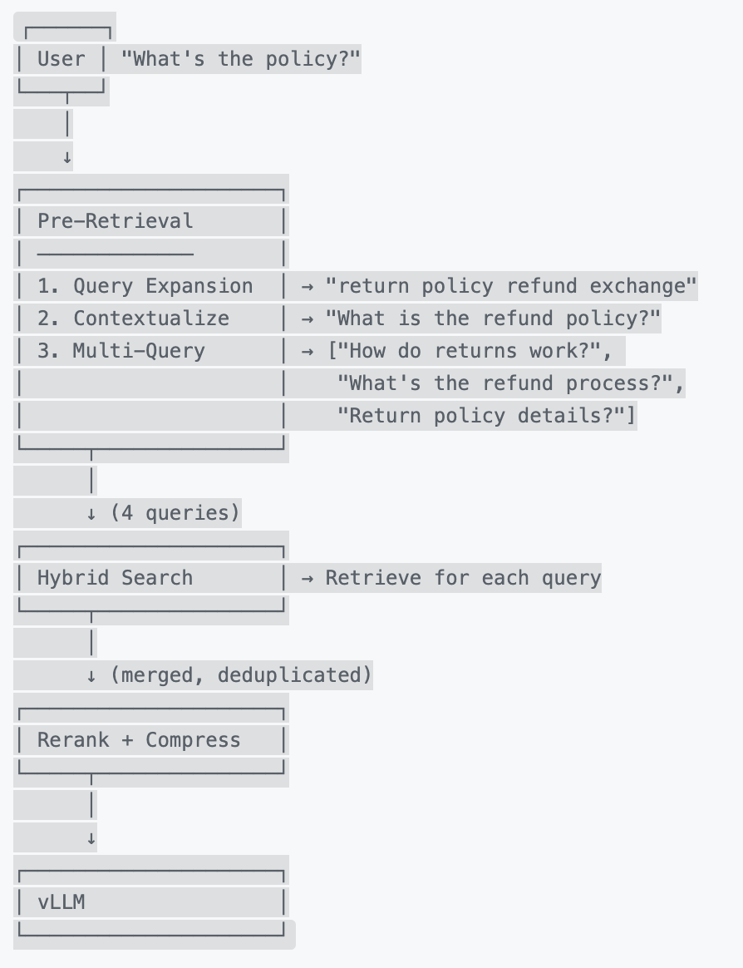
8 Pre-Retrieval Optimization
What This Adds
-Query Expansion: Adds related terms
-Contextualization: Resolves pronouns/references from conversation
- Multi-Query: Generates alternative phrasings, searches with all
Problem: User queries are often ambiguous or poorly phrased
Solution: Query enhancement before retrieval

Slide 14
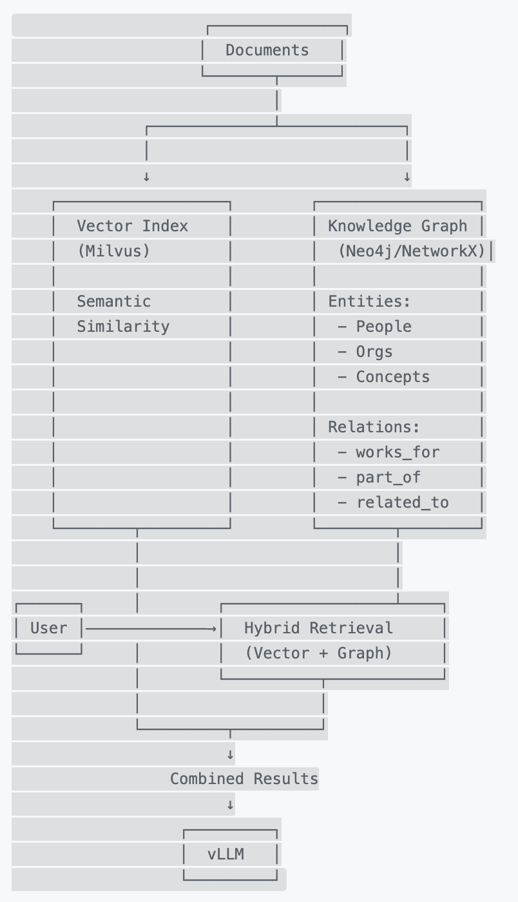
9 Graph-Based Retrieval
Problem: Pure vector search misses relationships (e.g., "Who reported to John in 2023?")
Solution: Knowledge graph with entities + relationships
additional LLM :
Flow
1.
What This Adds
-
Problems
-

Slide 15
8
Problem:
Solution:
additional LLM :
Flow
1.
What This Adds
-
Problems
-

Slide 16
SOTA
Re

Slide 17
Recap
Thesis
How agents may leverage hardware optimization and sustainable resource management in a RAG System
Last 2 weeks progress
RAG understanding (query → embed → retrieve → generate → Answer)
Agents learning
Literature - State of the art
Gaps finding

Slide 18
Research
State-of-the-art and Best Practices Decomposition
Agents
Hardware
RAG

Slide 19
Research RAG & retrieval efficiency
(CPU-heavy)
Hybrid retrieval with BGE-M3 (dense + sparse) Already implemented
best accuracy/recall but adds CPU work (tokenization, scoring merges).
Leads, What to try now : tune params, multiphase ranking
Hardware paths:
CPU SIMD/AVX-512 (Stay in CPU but use different instruction sets)
for vector ops can beat naïve GPU offload for small batches.
Milvus GPU only pays off when enough data at once
For small or few queries CPU wins
Caching/rehydration
- save results for frequent queries
- shard per-collection (Search only relevant data subsets)
- HyDE prompts Already implemented

Slide 20
Research Generator efficiency
(GPU-heavy)
Prefill dominates compute
(O(n²) on context length)
→ use efficient Attention (flashAttention) = break prompts into chunks and keep prompts short and well-structured.
Decode is limited by how fast data moves, not raw compute
→ speculative decoding
→ KV-cache reuse/pinning + continuous batching smooths utilization and lowers J/token.
Model Compression
→ pruning/distillation (less parameters – Really good accuracy)
KV-cache mgmt.
right-size max_tokens, evict aggressively between steps in agent loops; avoid needless context carryover.
Notes:
dense = what it’s about
sparse = what it says
Speculative :
Small model : light and cheap /token.
Large model runs fewer, larger parallel evaluations instead of many tiny sequential ones.
GPU utilization is smoother (less idle), memory reuse (KV) is more efficient.

Slide 21
Research Agentic orchestration
Agent loops are serial
(Act→Reflect→Act…) = latency adds up
the control flow + tools on CPU often dominate (≈90% in studies) REALLY BAD FOR OUR RESEARCH
Difficulty-aware orchestration (DAAO-style)
routes easy turns to small LLMs and shortens tool chains; hardest turns get the full stack.
Dynamic retriever ≠ “free”
on-demand features (HyDE, re-rankers, web tools) explode steps; must be meter-driven, not always-on.
Graph/Agentic-Graph RAG
Graph reasoning connects many docs for better logic but uses lots of CPU, GPU, and memory

Slide 22
Research System-level co-design (pipeline)
RAGO-style scheduling
choose placement (CPU vs GPU vs XPU), resource allocation (how many threads/cores)
find the quality-per-Joule Pareto rather than single-component maxima
Edge/on-device surveys
limited hardware exist but agentic workflows remain immature
→ research space for energy-aware agents

Slide 23
Research System-level co-design (pipeline)
RAGO-style scheduling
choose placement (CPU vs GPU vs XPU), resource allocation (how many threads/cores)
find the quality-per-Joule Pareto rather than single-component maxima
Edge/on-device
limited hardware exist but agentic workflows remain immature
→ research space for energy-aware agents

Slide 24
Research Evaluation Metrics
Task quality
RAGAS
System
GPU VRAM Usage (headroom, the buffer against OOM errors) and KV cache evictions)
Latency (generation speed, retrieval + prompt processing cost, user experience, …)
Power Consumption (Joules) (total "use" for a single request over time → J/token)
CPU Utilization (%) : component latency and cost "Is the CPU-bound RAG step slow?”
GPU Utilization (%) : throughput and cost
Consider age of the components, usage, degradation → Improvement long term ? Best usage, no peak ?
Same questions ? Same results ? Variance ? → Same questions ? Should be smaller since the system “learnt” ?
If no metrics
Features to activate on workload tpye
HyDe
Ranker

Slide 25
Research Insights and Gaps
Optimize the loop, not only the LLM
For agentic RAG, CPU-bound control flow + retrieval often dominate latency/energy. Pure GPU/LLM tweaks miss most of the win.
Difficulty awareness pays
A lightweight router that classifies turns by hardness and short-circuits tools/LLMs seem to cut Costs
Minor quality impact.
Retrieval policy is a throttle
HyDE/rerankers help quality but should be conditional (entropy/uncertainty-triggered), not default.

Slide 26
Research Insights and Gaps
Prefill vs decode require different hardware optimization
prefill → attention optimizations (heavy compute, once)
decode → KV/cache + speculative decoding (lighter compute, bandwidth-limited)
Graph-style agents are niche
reserve for queries that demonstrably need multi-hop reasoning; otherwise they inflate CPU/GPU time and memory.

Slide 27
Research Hypothesis
H1 — Router ROI
A 2-stage router (small LLM for easy, R-4B for hard) J/token reduction and quality standard ?
H2 — Conditional retrieval
Enabling HyDE + re-rank only when retriever uncertainty > τ → Latency decrease ?
H3 — KV/cache discipline
Observe change in KV reuse + max-new-tokens : Token/s increase and VRAM peak decrease ?
H4 — CPU SIMD vs GPU DB
For your typical batch size (<N), CPU-SIMD retrieval beats GPU-Milvus on latency/J ?

Slide 28
Google, ETH, Google DeepMind – March 2025
RAGO: Systematic Performance Optimization for Retrieval-Augmented Generation Serving
https://arxiv.org/abs/2503.14649
Research Best papers
RAGO (Systematic Performance Optimization for RAG Serving)
co-optimize task placement, resource allocation, and batching across CPU/GPU in RAG.
It performs system-level co-optimization by making key scheduling decisions for the entire RAG pipeline 40:
Task Placement, Resource Allocation, Batching Policies
Why important ?
gives a method to jointly tune Milvus( CPU/GPU ) + vLLM + batching and measure different metrics at the pipeline level, not just the LLM

Slide 29
Jinwei Su, Qizhen Lan, Yinghui Xia, Lifan Sun, Weiyou Tian, Tianyu Shi, Lewei He - Sept 25
Difficulty-Aware Agentic Orchestration for Query-Specific Multi-Agent Workflows
https://arxiv.org/abs/2509.11079
Research Best papers
Difficulty-Aware Agentic Orchestration (DAAO)
Proposes a router + difficulty estimator (VAE) that picks the cheapest viable workflow/LLM per query.
1. Predicts how “hard” a query is before running any heavy LLMs.
2. Chooses which tools or subagents are needed (retriever, reranker, calculator, etc.).
3. Selects the appropriate LLM
Generates query-specific multi-agent workflows
Why important?
Exemple of usage to build a small-model gate + conditional tools
(HyDE/rerank only when uncertain) to cut J/token and P95 with minimal quality loss.

Slide 30
Research Sources

Slide 31
Recap

Slide 32
BLA BLA
BLA BLA BLA BLA

Slide 33
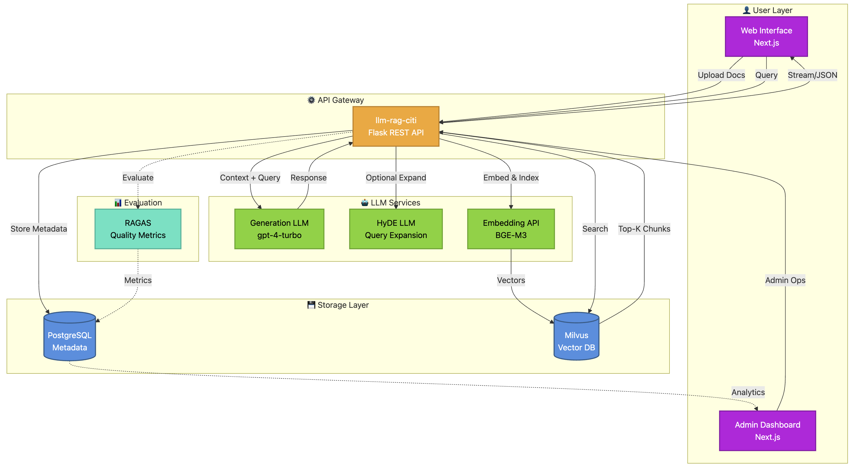
KCL – Architecture (simplified)

Slide 34
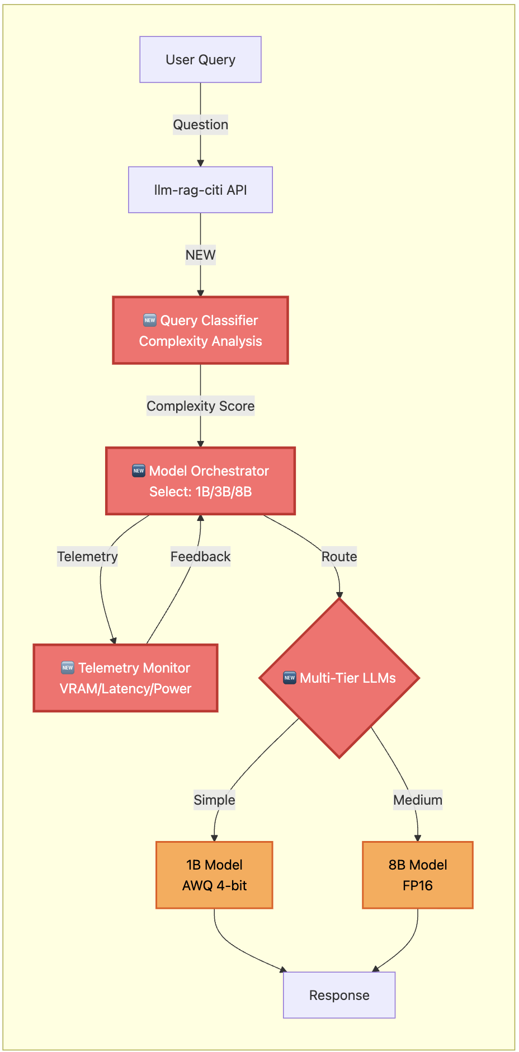
Agentic – A1 : Dynamic Model Selection Agent
Dynamic choice of model based on the query complexity
→ “Agent Orchestrator”
We would build :
  Query Classifier : extracts syntactic semantic features and classifies queries
Model Selection Module : Maps complexity tier to simple (low Parameters 1B - 3B) or complex (8B w/ fp16) precision models.
Confidence Checks
Metrics of success
VRAM reduction, latency savings, energy savings every 100 queries e.g.
Some possible issues
Multiple models, management layer required

Slide 35
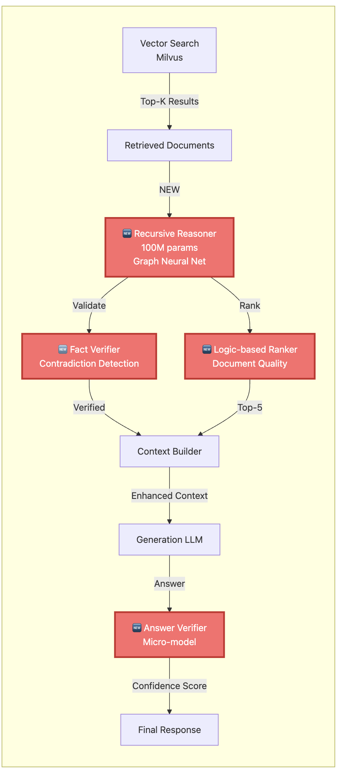
Agentic – A2 : Use of recursive Models (TRM)
ABANDONED
Replace the document-ranking / answer validation within the RAG with 2 tiny neural networks
Current State
Single monolithic LLM handles all reasoning
No specialized reasoning for sub-tasks
Document ranking done via Milvus vector similarity only
It brings :
Replace large generator for narrow reasoning sub-tasks (e.g., document ranking validation, answer verification)
TRM is a supervised learning model, can use the main LLM as ‘teacher data’ and distillate it.
Could act as microkernel
Limitations
currently a supervised method that provides a single deterministic answer

Slide 36
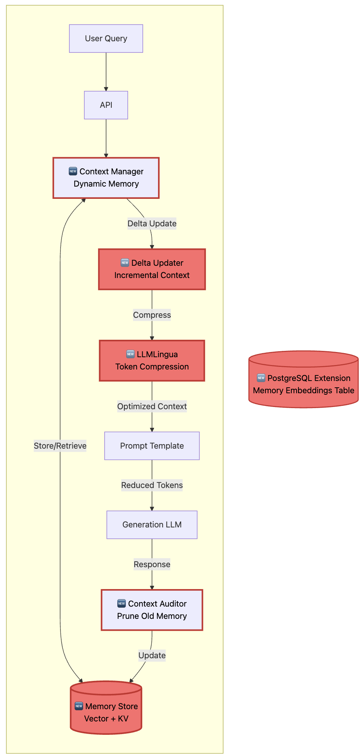
Agentic – A3 : Agentic Context Engineering
Dynamic system-prompts creating an evolving memory for operational context
We would build :
  Dynamics systems prompts (“smart” - log memory, incrementation, memory storage)
  Context compression
  Automatic updates (sub-memories, audits)
Gains
Reduce training -> Token usage reduction
Long term skill (assimilates all the ’know-how’)
Possible issues
memory storage layer Privacy concerns: storing user interaction patterns
centralized context migration
complexity
Based on the paper : Evolving Contexts for Self-Improving Language Models (Stanford University, SambaNova Systems, Inc. UC Berkeley, Oct 2025)

Slide 37
System Level – S1 : Further Quantization and Pruning
Push the current limits of quantization and pruning beyond Robin’s 4-bit optic
We could implement :
  Structured Pruning (aiming for higher compression)
    LLM-Pruner (no unstructured sparsity)
    Dynamic reduction based on VRAM (or other metric)
    …
  Quantization :
    AWQ (keeps high precision)
    Sub 4-bit
    Dynamic quantization
    …
Push the current limits of quantization and pruning beyond Robin’s 4-bit optic
Metrics of success
Latency / accuracy tradeoff
VRAM reduction
Cost per query
Use on edge devices (e.g. Raspberry PI)
Based on Robin’s Thesis : Optimizing RAG-Based KnowledgeManagement with Fine-Tuned Quantized LLMs [1]
Based on the paper Sustainable edge Ai (Apr 2025 - Kristiania University of Applied Sciences & SINTEF, Norway) [2]

Slide 38
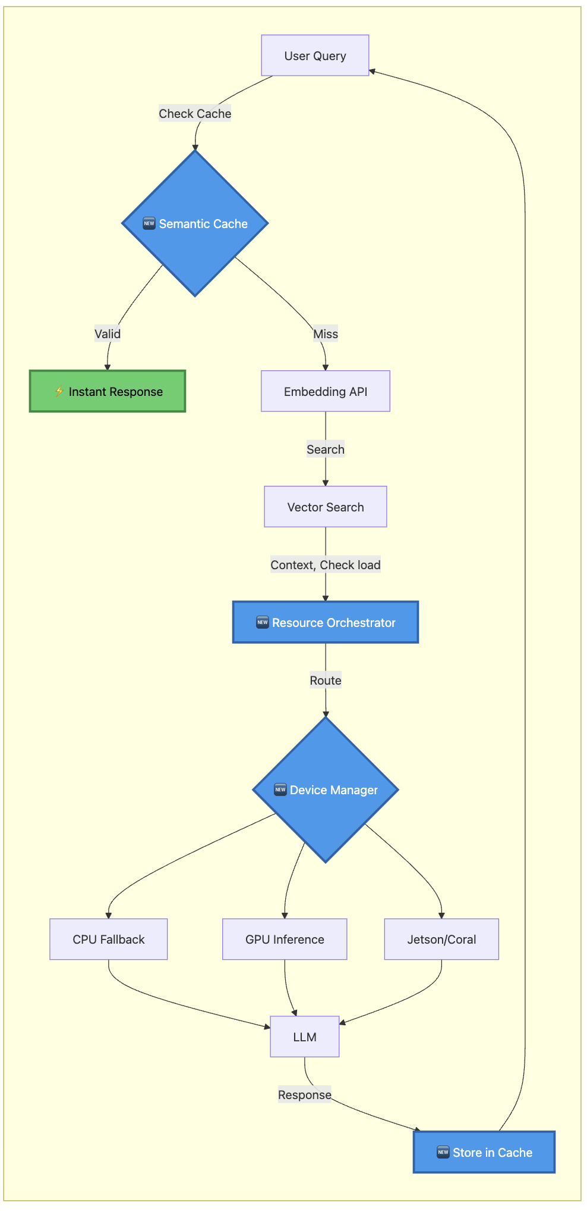
System Level – S2 Resource allocation
A. Implementation of an orchestration layer to assign computation to the “optimal path”
B. Reuses previously computed outputs through cace
We would build :
  Dynamics hardware allocation
    “smart” - log memory
    incrementation
    memory storage
    Allocation monitoring
  Semantic Output Caching
    check similarity to previous queries
    Retrieve queries by passing the retrieval
    Requires to handle outdated queries and answers -> Agents ?
Metrics of success
Inference time
Latency improvement (cached answers)
VRAM reduction for queries

Slide 39
Bibliography
[1] Thesis : How agents may leverage hardware optimization for
[2] Thesis

Slide 40
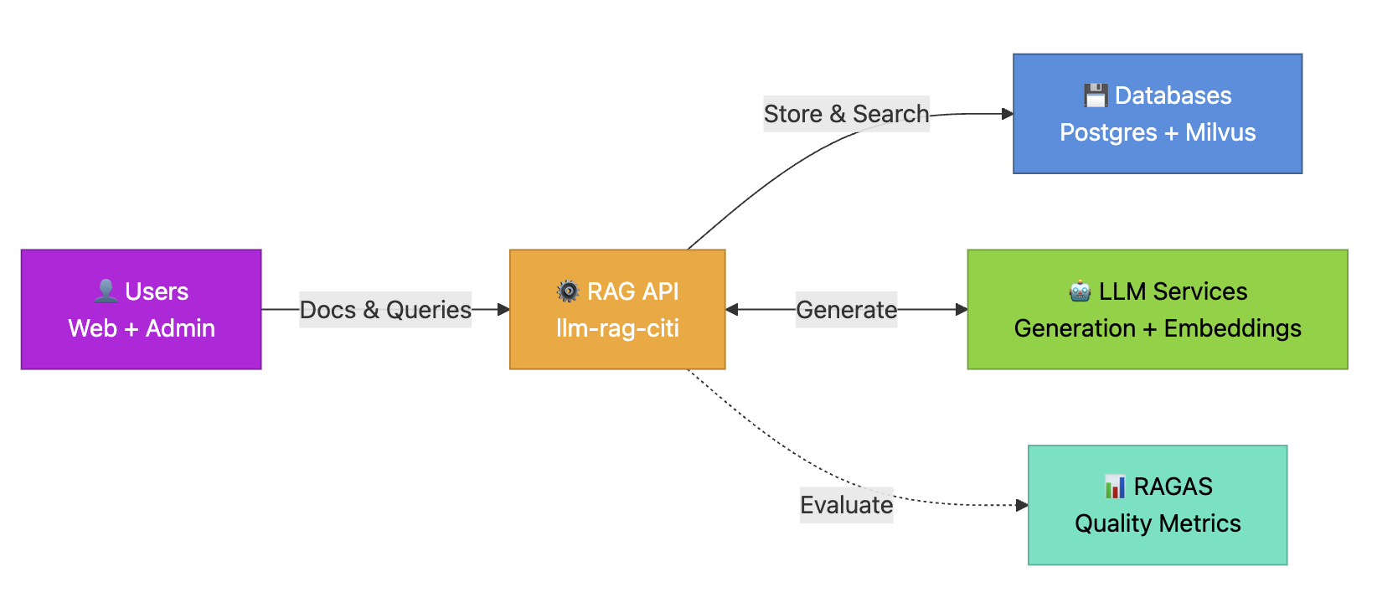
KCL – Architecture (ultra simplified)

Slide 41
KCL – Processing low
Query
Document
User Query → Front-end
↓
llm-rag-citi API (Flask)
↓
Semaphore (max 2 concurrent)
↓
[Optional] HyDE LLM → Query Expansion
↓
Embedding API → Dense + Sparse query vectors
↓
Milvus Hybrid Search (Private + Public collections)
↓
[Optional] Reranker → Top-5 docs
↓
Context Builder → Format snippets
↓
Prompt Template + Conversation History
↓
Generation LLM (Streaming/Async)
↓
SSE Stream → Front-end → Chat UI
↓
[Background] RAGAS Evaluation → PostgreSQL metrics
User → Front-end → Admin/User Upload
↓
Document Processor (MinERU/PyPDF)
↓
Text Chunking (RecursiveCharacterTextSplitter)
↓
Embedding API (BGE-M3) → Dense + Sparse vectors
↓
Milvus Insert (Private/Public collection)
↓
PostgreSQL Metadata (Document table, vdb mapping)

Slide 42
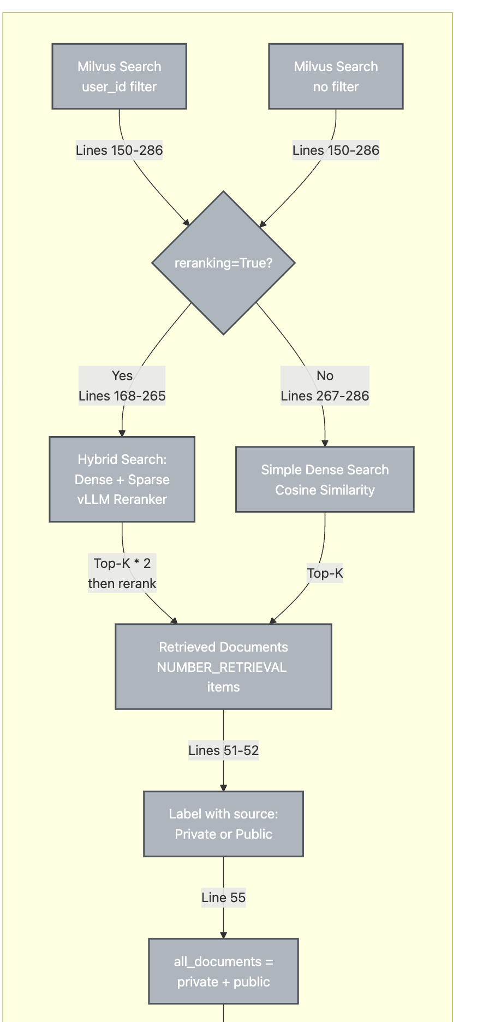
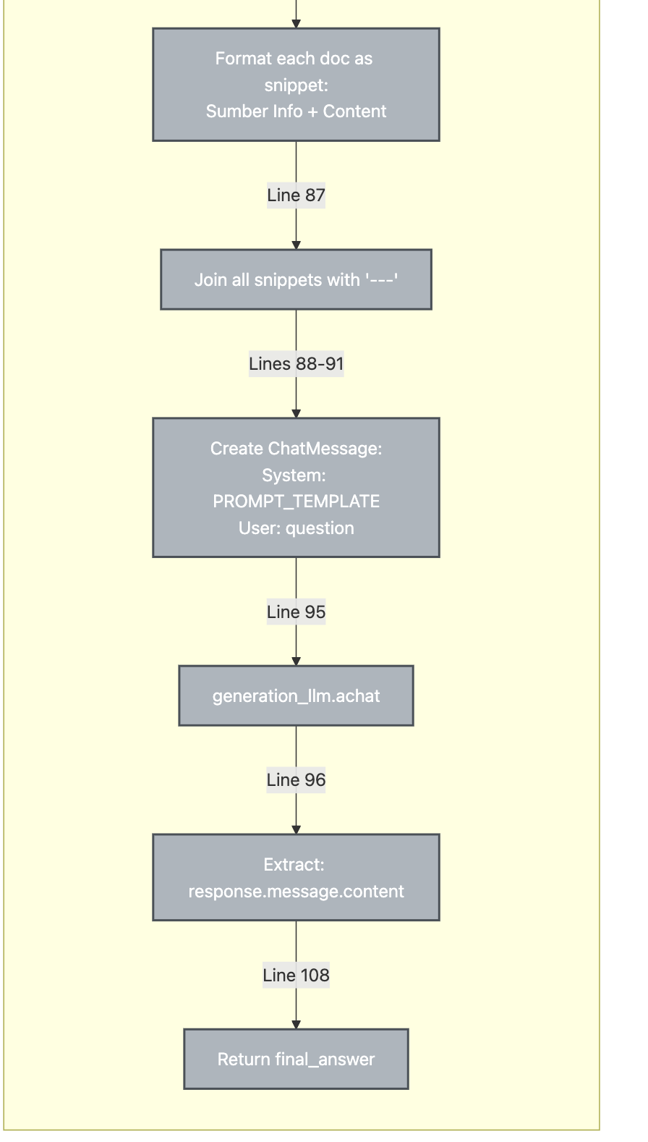
Agentic – A2 : Use of recursive Models

